Slide 1
IOT Project
Proof Of Concept for Smart Scheduling Irrigation System

Slide 2
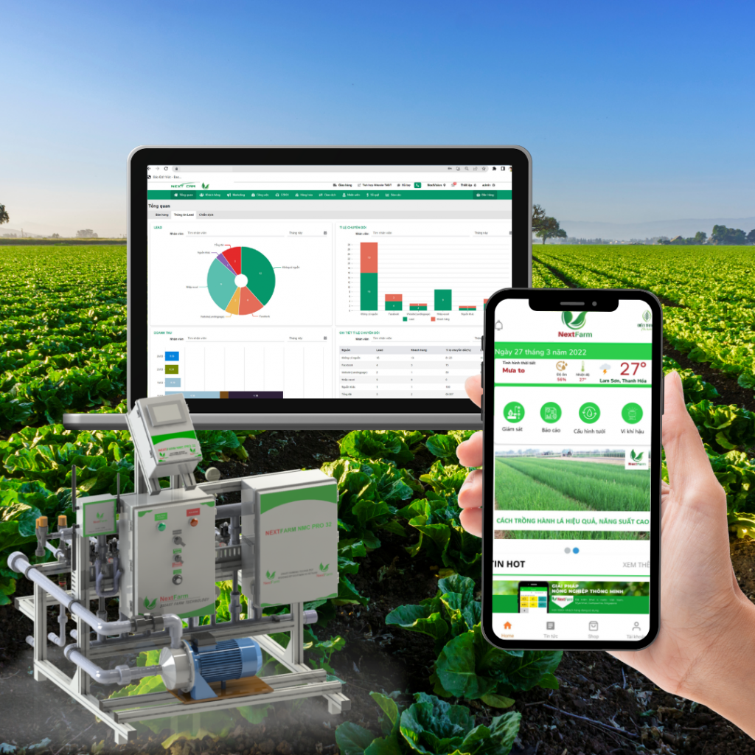
Related Projects
NextFarm from Viettel
Fertilizer mixer machine
Scheduling operations
FarmBeat from Microsoft
https://www.microsoft.com/en-us/research/project/farmbeats-iot-agriculture/

Slide 3
Project Introduction
An irrigation system, having 8 actuators (Relays) using Modbus 485:
3 for fertilizer mixer (ID = 1 2 and 3)
3 for area selector (ID = 4 5 and 6)
1 for pump in (ID = 7)
1 for pump out (ID = 8)
Sonar sensors will be provided, but their data cannot be used since there is no water connected to the system.
Your design must be consider the sensors values
But in your demo, devices stop based on timer event (timer expired)

Slide 4
For example
When the irrigation process is started, the first fertilizer tank(we have 3 in total) is activated. We need to fill 20ml from the first tank. The relay having ID = 1 is activated, waiting for 20ml from the flow sensor or after 10s, this Relay is stopped. A notification can be sent to the smart phone device, to alarm that the flow sensor has to check!!!
After the fertilizer mixer process is finished, the water pump-in (ID = 7) process is activated, but since there is no water, after a predefine timeout, this pump is stopped (e.g. 20 seconds)

Slide 5
Data format example (3 objects maximum)
[
{
"cycle": 5,
"flow1": 20,
"flow2": 10,
"flow3": 20,
"isActive": true,
"schedulerName": "LỊCH TƯỚI 1",
"startTime": "18:30",
"stopTime": "18:40"
}
]
Wait until the start of irrigation
Mixer 1 is started
Mixer 2 is started
Mixer 3 is started
Pump in is started
Pump out is started
Wait until the next cycle
Wait until the end of irrigation

Slide 6
FSM Example (Indicate the condition)
IDLE
MIXER1
MIXER2
MIXER3
PUMP
IN
SELECTOR
NEXT CYCLE
PUMP
OUT

Slide 7
Requirements for your Report
Introduction to the Project
Advanced features based on AI, Data Mining or Data Analytics
System Analytics and Design
Using FSM
Using Scheduler and Tasks
System Development
The format of your data (for updating the irrigation scheduler from Mobile App to the CM4)
Your app on the embedded platform using CM4
Your mobile app
Your web app
Your AI
System Validation and Experiment

